Slide 1


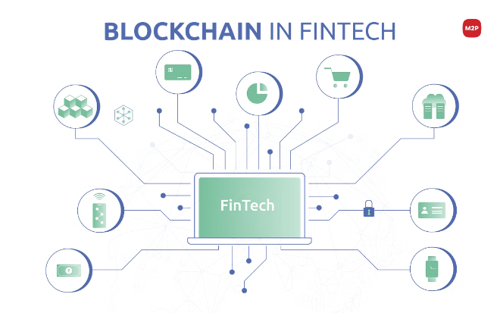
Blockchain-based Microfinance Platform
Empowering Financial Inclusion through Decentralization
Team:
DApp Developers
Members:
Chakradhar, Jaswanth Aditya, Mahesh Datta
College: IIIT Sricity

Slide 2

Problem Statement
1
Lack of Access
2
High Fees
Millions in developing countries lack access to traditional banking and financial services.
Existing microfinance institutions often charge high-interest rates and fees.
3
Inefficiencies
4
Trust Issues
Traditional microfinance operations are inefficient and prone to delays and errors.
Borrowers and lenders face trust issues due to lack of transparency and accountability.

Slide 3

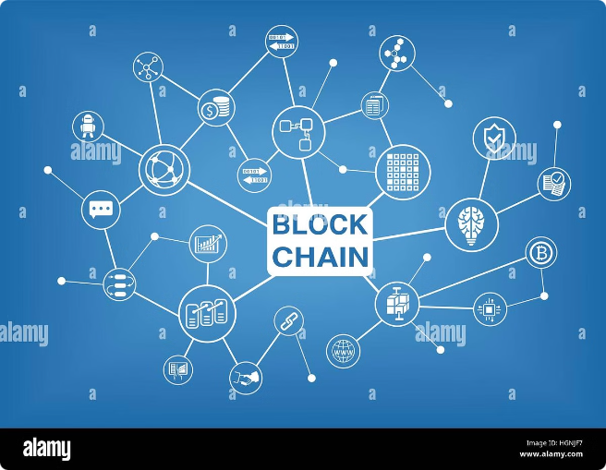
Our Idea
Decentralization
Utilize blockchain technology to create a decentralized microfinance platform.
Peer-to-Peer Lending
Facilitate direct lending between individuals, reducing the need for intermediaries.
Transparency
Ensure all transactions and agreements are recorded on the blockchain for transparency and trust.
Automation
Use smart contracts to automate loan agreements, disbursements, and repayments.

Slide 4
Solution Approach
1
User Registration
Users create accounts and undergo identity verification.
2
Loan Creation
Borrowers create loan requests specifying amount, interest rate, and repayment terms.
3
Funding Loans
Lenders browse loan requests and fund loans directly through the platform.
4
Smart Contracts
Smart contracts govern loan agreements, ensuring automatic disbursements and repayments.
5
Repayment Tracking
The platform tracks repayments and updates lender balances automatically.

Slide 5
Features
Secure User Authentication
Loan Marketplace
Smart Contract Automation
Ensuring secure and verified user access.
A transparent marketplace for borrowers and lenders.
Automated execution of loan terms and conditions.

Slide 6

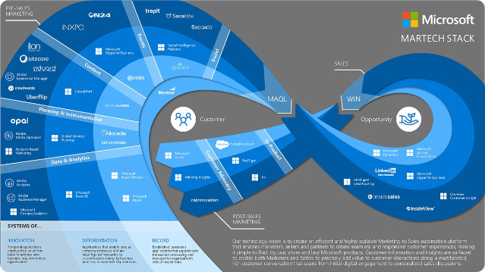
Tech Stack
Frontend
React.js
Blockchain Interaction
Web3.js
Smart Contracts
Solidity
Backend
Node.js with Express
Database
MongoDB (optional)
Wallet Integration
MetaMask

Slide 7






Solution Architecture
User Interface
React.js application
Blockchain Node
Ethereum (Rinkeby testnet)
Wallet Provider
MetaMask
Blockchain Interaction
Web3.js
Backend
Node.js server
Database
MongoDB (optional for extended features)

Slide 8
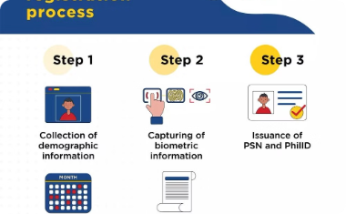
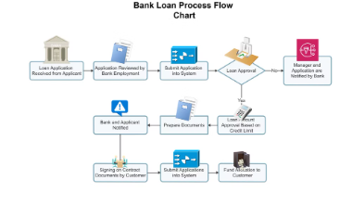

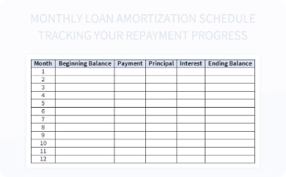
Demonstration
Registration Process
Create Loan Request
Fund a Loan
Automated Repayment
Walkthrough of user registration and verification.
Demonstrate creating a loan request.
Show how a lender funds a loan request.
Display how repayments are tracked and updated.

